Slide 1
Lecture 11 – A brief introduction to Engineering Economics

Slide 2
Overview
This is a short introduction to engineering economics
The most important concept for you to learn from this briefing is the time value of money
  A set amount of money has different value based on when the money is available or required
These computations are used extensively in the private sector where there can be multi-year fiscal planning and where funds can be invested to accumulate interest over time
These calculations are not used as much in the government sector where money cannot be invested
  There is however a critical calculation regarding time value of money that you need to be able to perform for government projects that we will discuss
Notes:
This is a short introduction to a field that is normally covered in a full term course. The basis for all engineering economics is understanding that the same quantity of money has different value based on when you are evaluating the value.

Slide 3
Economics
Virtually all engineering decisions – safety, ethics, legal compliance – are economic and require the use of evaluation tools for cost/benefit analysis
A critical concept is the Time Value of Money
Money is not only represented by a magnitude but also has a set of time effects on its value
  Inflation reduces a dollar’s buying power
  Dollars sitting in a pocket are lost opportunity – could be used to generate income in rather low risk ways (interest)
Constant year dollars is the term we use to describe expression of monetary values assuming they are at the same year and that year is unchanging
  Constant year dollar budgets/costs are a snapshot in time
  Constant year dollars are necessary to compare costs/budgets spread over different years
    Provide for an “apples to apples” comparison
Real Year dollars is the term use to describe expression of monetary values in the years that they are budgeted or expended
Notes:
Understanding the difference between constant year dollars and real year dollars is critical to understanding any budget or cost projection. The first question asked should always be “Are these constant year or real year dollars”. In general, because inflation is usually increasing the quantity of dollars that you will need in any future year will be greater than your projections in constant year dollars. I have seen major projects run into huge budget problems because they projected in constant year dollars but then failed to convert into real year dollars when submitting budgets. If you work on one to two year budget cycles, this effect is not large. But in 5-10 year budgets this can be disastrous.
Real Year dollars can best be explained by thinking about budgeting a project. You know what materials and manpower will cost today. But next year due to inflation, salaries and the costs necessary to produce materials will be more. The difference in salaries and materials de to inflation is the difference between real year and constant year dollars.
This becomes a major factor in projects that stretch over multiple years. If all you do is projects within a single budgeting year, this becomes significantly less important.

Slide 4
Economics
Interest
  Whether you are receiving interest (your money invested) or paying interest on money you have borrowed, interest is the “rental charge” for the use of money. Payments include a partial payment for the borrowed amount plus rental fee
  Simple Interest (seldom used)
  You borrow $500 at 8% interest. Annual interest is $500*.08 = $40

Slide 5
Economics
Annual compounding (applied to a lump sum)
  Compounding is the process by which interest earns interest
  Example 1. (At an annual rate)
    End of year 1 500 x 0.08 + 500 = 540
    " " " 2 540 x 0.08 + 540 = 583.20
    " " " 3 583.2 x 0.08 + 583.2 = 629.86
  Compounding formula evident by inspection:
  Year Interest during yr Balances at end of year
  1 P(i) P + P(i) = P(1+i)
  2 P(1+i)(i) P(1+i) + P(1+i)(i) = P(1+i)^2
  3 P(1+i)^2(i) P(1+i)^2 + P(1+i)^2 (i) = P(1+i)^3
  . . .
  N P(1+i)^n-1(i) P(1+i)^n-1 + P(1+i)^n-1 (i) = (P1+i)^n

Slide 6
Economics
Example 2.
With annual compounding, what is the amount due on a $500 loan after 5 years at 8 % interest?
  Future Worth = FW = 500 (1 + 0.08)^5 = $734.66
  Future Worth (FW) is the term used in engineering economics to project a current or Present Worth (PW) of money into the future assuming interest or inflation rates
Interest is usually compounded more often than annually.
If i is the annual interest rate, i/2 represents semi-annual rate, i/4quarterly rate.
In the formula FW = PW(1+i)^n can generalize formula to FW = PW(1+i/m)^mn
Where i = annual interest rate, m = number of compounding periods and n= number of years

Slide 7
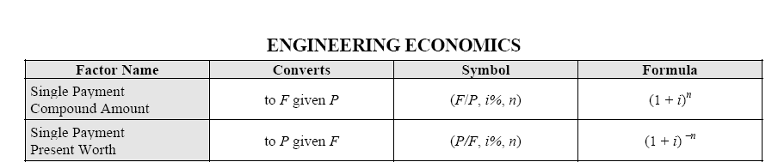
Economics
With this equation it is now possible translate the value of money to a common basis
From the NCEES Fundamentals of Engineering Reference Handbook

Slide 8
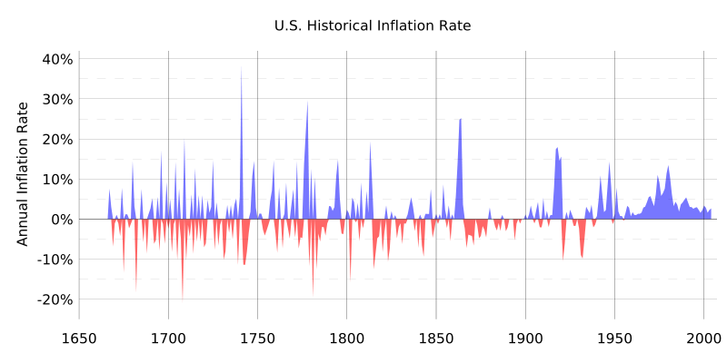
Inflation and Budgets
Inflation, the time change effect on money, is just like interest
Def - Inflation from Wikipedia - Inflation is a rise in the general level of prices over time. It may also refer to a rise in the prices of a specific set of goods or services. In either case, it is measured as the percentage rate of change of a price index.
For government budgeting, we use an Office of Management and Budget (OMB) specified inflation rate for planning and converting constant year dollars into real year dollars to account for inflation
This may or may not reflect actual inflation effects on cost of materials, manpower etc…
Inflation in government planning is compounded annually
Note post war years
Civil war
WW1
WW2 and Korea

Slide 9
The importance in managing projects
So if you have a set amount of effort required to do a task expressed in current year dollars
That same effort may require different budget to complete
  If stretched out to a longer period of time
  If just shifted to the same amount of time but in a later year
Bottom line – when a project is spread over multiple years or is postponed, the same effort will almost always cost more in real year dollars
Notes:
This is a very imprortant effect. Often organizations are trying to do way more than their resources will allow so they often stretch projects out so that their budget requirements for any given year for any specific project are less, allowing them to spread limited resources across multiple projects. Although this may be an operational necessity and may even be good management in certain cases, it comes with a cost. Projects spread out over multiple years always cost more in real year dollars due to the effect of inflation.

Slide 10
assuming 5% constant inflation
Dollars are in $M
 | Year 1 | Year 2 | Year 3 | Year 4 | Year 5 | Total
Inflation Factor | 1 | 1.05 | 1.1025 | 1.157625 | 1.215506
Scenario 1 - all in current year
Investment in current year dollars | 10 | 0 | 0 | 0 | 0 | 10
Investment in real year dollars | 10 | 0 | 0 | 0 | 0 | 10
Scenario 2 stretched out to 4 years
Investment in current year dollars | 2.5 | 2.5 | 2.5 | 2.5 | 0 | 10
Investment in real year dollars | 2.5 | 2.625 | 2.75625 | 2.894063 | 0 | 10.77531
Scenario 3 - delayed two years in the future but still completed in 1 year
Investment in current year dollars |  |  | 10 |  |  | 10
Investment in real year dollars |  |  | 11.025 |  |  | 11.025
Scenario 4 - delayed one year and completed in 4 years
Investment in current year dollars |  | 2.5 | 2.5 | 2.5 | 2.5 | 10
Investment in real year dollars |  | 2.625 | 2.75625 | 2.894063 | 3.038766 | 11.31408
Notes:
This chart shows a project over four different scenarios assuming a constant 5% year inflation rate. In the first scenario, a $10M projects is all completed in a single year costing $10M in both constant year and real year dollars. The second scenario shows the project stretched out to 4 years. The content of the project is the same in all four scenarios so the constant year value is the same. However the real year cost is significantly larger due to inflation. For example in scenario 2, the same content costs $10.7M In scenario 3, the same project has been delayed two years and then still is completed in a single year. This scenario, even though it has the same content as the first scenario, in the end costs 11.025M. In the fourth scenario the project has been delayed one year and then stretched out to four years. Even though the peak funding is less on any given year , the total cost for the project is 11.3M.

Slide 11
International Space Station Budget Crisis
In 2001, the International Space Station had a significant budget crisis
  Identified a $4B overrun
Approximately half of this “overrun” was not overrun at all, but represented the change in the time value of money as the program was delayed on the ground due to problems in the launching Russian segment
  Because this had not been tracked or explained (or even well understood) , it was all presented as “overrun” resulting in major alterations to ISS program
    Major content, the habitation module and the crew return vehicle as well as major science experiments for the station, were deleted.

Slide 12
From Space.com 17 Oct 2001
The task force's (on Space Station budget overruns) recommendations and NASA's willingness to embrace them could determine how much faith the White House and Congress are willing to invest in the agency's vision. The president's budget officials have said overspending on the space station could undermine manned spaceflight to the moon and beyond.
But the proceedings got off poorly a month ago in Houston. Auditors were shocked by a NASA briefing that called for a $2.5 billion bailout plan that would offset the overruns and allow for a larger-scale space station.
Instead of support, the presentation prompted a terse lecture from Thomas Young, chairman of the task force. He warned NASA managers to give up any hope of a bailout. The task force is expected to provide a draft of its recommendations to the NASA Advisory Council in two weeks. The report might be made public in a few months.
Taxpayers learned this summer that NASA faced a $4.8 billion cost overrun on the space station. To save money, the agency was forced to kill a habitation module and crew-escape vehicle, among other components. It also slashed science spending on the station by about 40 percent. Scientific experiments were a primary purpose for the program.
Notes:
I was at this meeting and it was not a pretty sight. Over the next 4 months we developed a better and better story on how the budget gap developed and over $1B of it was due to schedule slips and another $2B of it was due to congressionally directed content increases that did not have corresponding budget increases in the constant year projected estimates for the project. If we had been able to explain this the first time we met with the task force, we might have fared better. But because we couldn’t explain it very well, the task force got onto a “delete content” train of thought that we were unable to effect when we finally got our story straight.

Slide 13
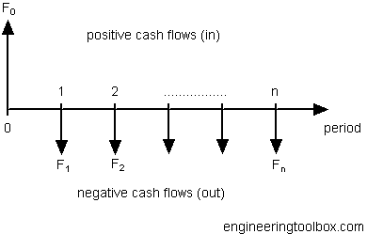
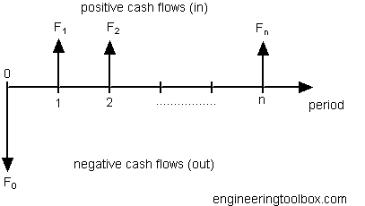
Cash Flow Diagrams
Used to express flow of money over time
Loan transaction
Investment Transaction

Slide 14
Example – Fixed Series of Payments
From the receivers viewpoint
1 2 3 4
1 2 3 4
From the payers viewpoint
Notes:
Whether the arrows go up or down on the cash flow diagram depends on your viewpoint. If you are receiving cash from a transaction, the arrows go up reflecting a positive cash flow. If you are making a serie sof payments, the cash flow is negative and the arrows go down.

Slide 15
To Compute Value of Fixed Payments
To compute future value of a series of payments over time used to generate funds for future requirement (college fund or equipment replacement)
Example $500 year paid every year for 4 years at 5% interest results in $500*(((1.05)^4)-1)/.05 = $2155 at the end of 4 years
To compute the current value of a series of payments (to compare a rental to purchase of equipment)

Slide 16
To compute how much an annual amount needs to be :
To compute what annual value you would have to invest to have a future value of a certain amount (how much do I need to put away for a future requirement – called a sinking fund)
Example – you need to buy something in 10 years for an estimated value in that year of 16,000. With interest 8%, how much must you put aside every month ?
a=16,000*(.08/((1.08^10)-1))=1104.50

Slide 17
This is just an introduction
There are many other variations in these themes with graduated payments and costs to cover cases where the payments are changing over time (such as increased maintenance costs)
To do a cost benefit analysis problem, these equations must be used to put all values being compared in the same type of dollars
  Current year/present worth or real year/future worth
When comparing costs it is also vitally important to be working in the same types of money

Slide 18
Any Questions ?

